Slide 1
Model View Controller (MVC)
The MVC is an architectural pattern that separates an application into three main logical components Model, View, and Controller.
Each of these component has their own role in a Project.
MVC model was first introduced in 1987 in the Smalltalk programming language.
More than 80% of all web app frameworks rely on the Model View Controller architecture.

Slide 2
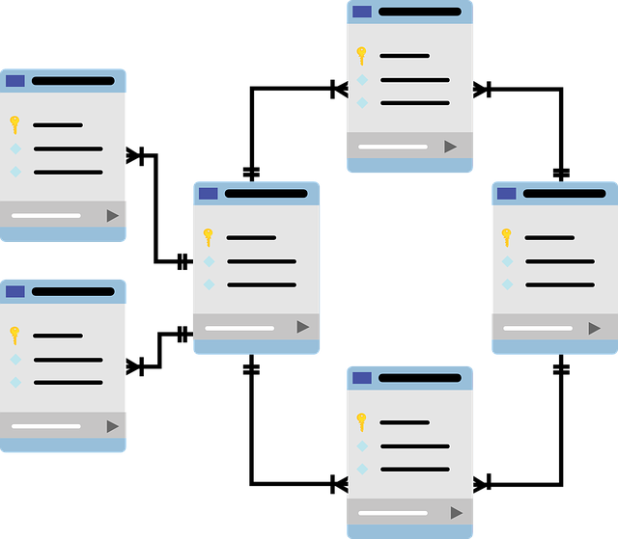
Model
The model is responsible for getting data from a database, packaging it in data objects that can be understood by other components, and delivering those objects, most of which will happen in response to input from the controller.

Slide 3
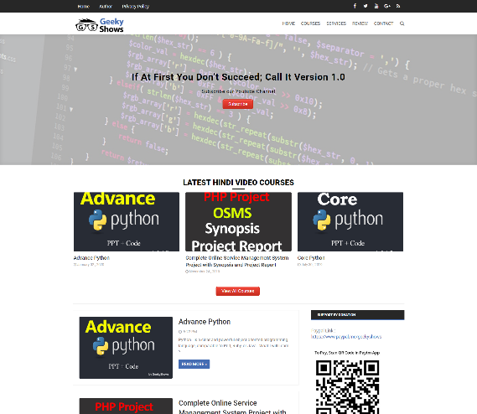
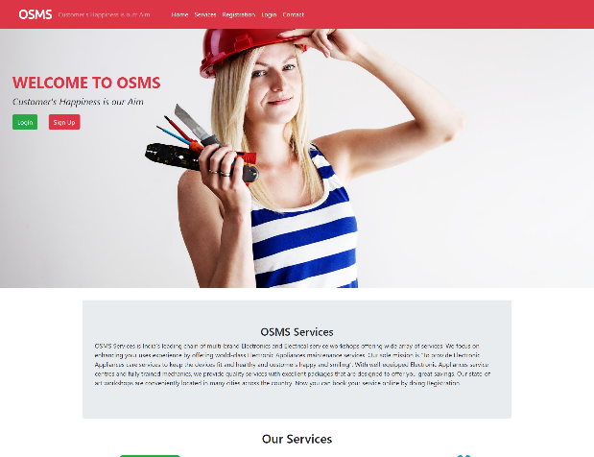
View
It represents how data should be presented to the application user. User can read or write the data from view.
Basically it is responsible for showing end user content, we can say it is user interface.
It may consists of HTML, CSS, JS.

Slide 4
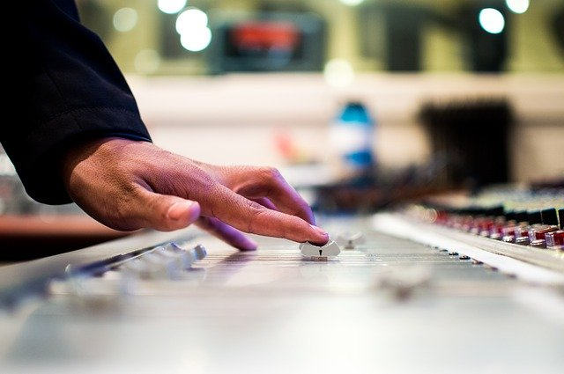
Controller
The user can send request by interacting with view, the controller handles these requests and sends to Model then get appropriate response from the Model, sends response to View.
It may also have required logics.
It works as a mediator between View and Model.

Slide 5


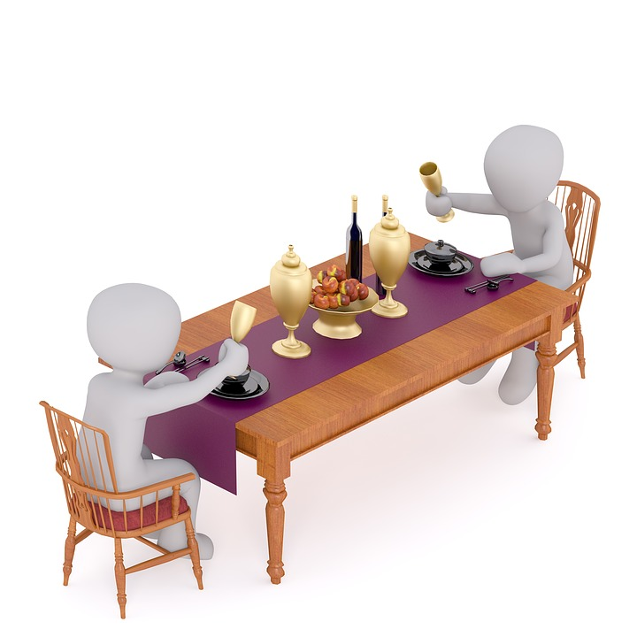
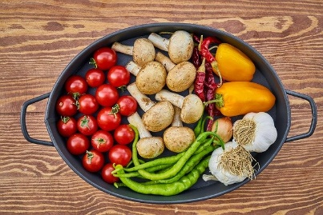
Take Order
Pass Order info to Cook
Receive Food from Cook
Serve to Customer
View
Controller
Model
Access Vegetables
Food
Order Food
Eat Food
May order for food
Data

Slide 6
Server Side Logic
Process GET/POST
Get data from User
Pass data to Model
Gets data from Model
Pass data to View
Controller
Process Data
Insert/Update DB
Communicate with Controller
Model
Routing
View
Database
User Interface
HTML/CSS
Get Data from Controller

Slide 7
Why use MVC
Organized Code
Independent Block
Reduces the complexity of web applications
Easy to Maintain
Easy to modify

Slide 8
Basic Structure
Assets
CSS
Images
JS
Config
Database Config File
Controllers
Model
Views

